Slide 1
Rules of Golf
A Love/Hate Relationship
Robin Gallagher
Volunteer Rules Official, CGA

Slide 2
Topics-
References
Free Relief
Movable Obstructions
Immovable Obstructions
Abnormal Course Conditions
Penalty Relief
Red and Yellow Penalty Relief
Lost Ball and Provisional Ball
Around the Green
Marking you ball
Match Play vs. Stroke Play

Slide 3
Content References
USGA Rules of Golf Official Guide effective January 2023 and Online USGA Rules of Golf https://www.usga.org/rules/rules-and-clarifications/rules-and-clarifications.html#!ruletype=fr&section=definitions
The Roving Official-Scott Newman; https://www.therovingofficial.com/default.php
Jay Roberts USGA Certified Rules Expert Jay Roberts Golf – YouTube

Slide 4
Free Relief-Rule 15,16
Lose Impediments 15.1
Moveable Obstructions 15.2
Most often Natural
Pine Needles
Dead loose grass clippings
Leaves
Fallen Tree limbs
If ball moves in process 1 stroke penalty and ball must be replaced
Artificial Objects
Rake
Trash
Items left behind by previous groups
Red or Yellow Stakes
If ball moves in process NO penalty and ball must be replaced

Slide 5
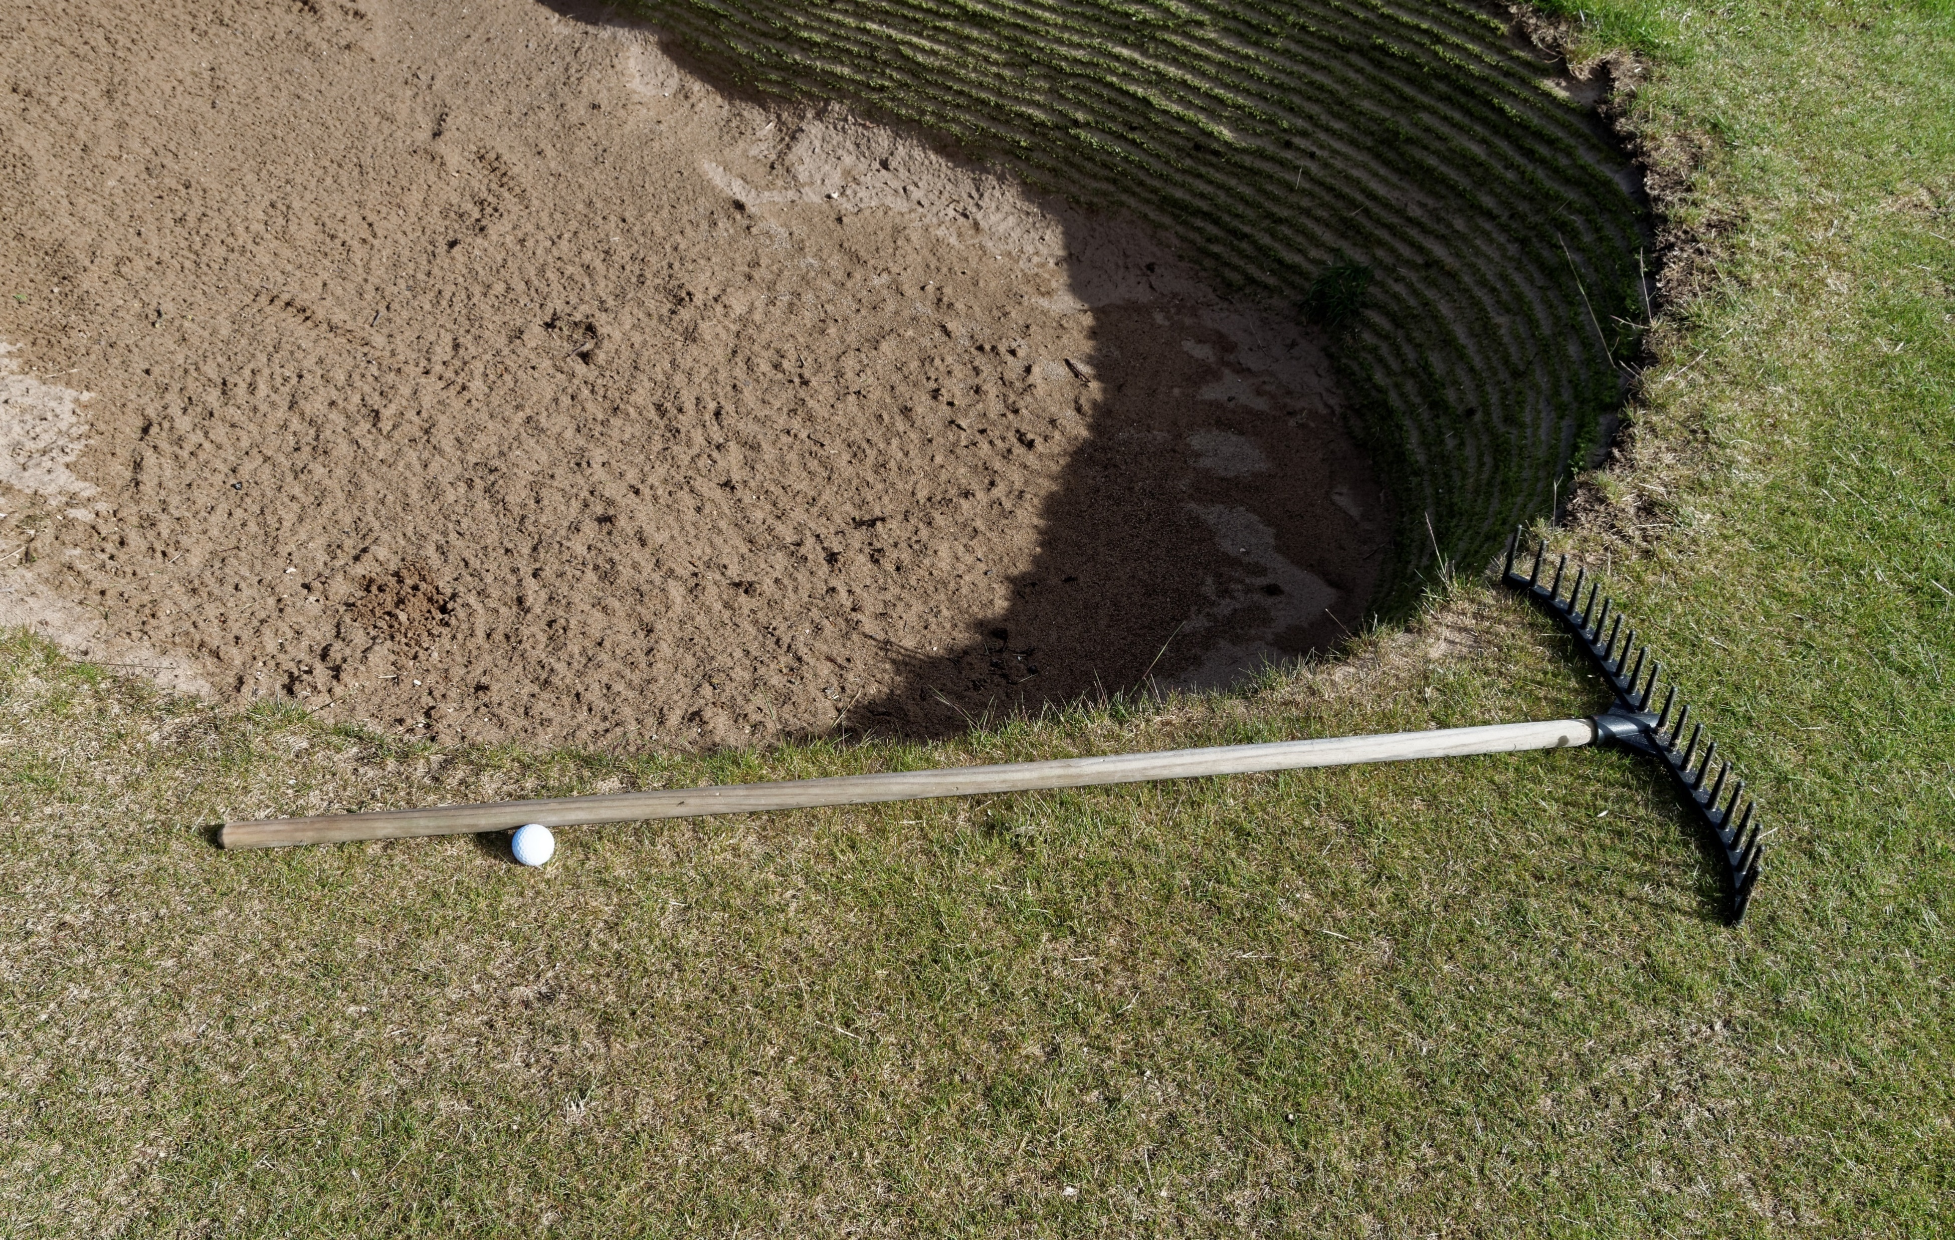
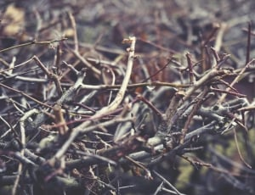
Loose Impediments & Movable Obstructions
Obstructions that can be moved with reasonable effort and without damaging the obstruction or the course.
Examples: pebbles, twigs, leaves, trash, rakes, red or yellow stakes, cart path stakes/roping on most courses
The Rules on Movable Obstructions in Golf (youtube.com)

Slide 6
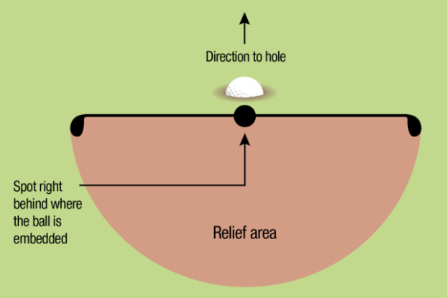
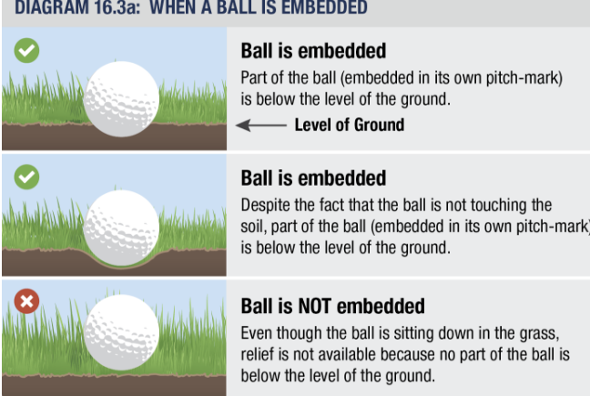
Free Relief-Rule 15,16
Abnormal Course Conditions (ACC) Rule 16.1
Anywhere on course (Except from penalty areas and does not allow for line of play or line of sight relief. Complete Relief must be taken.)
Ground Under Repair
Dangerous Animal Conditions Rule 16.2 (i.e. bees, fire ants, alligators)
Integral Objects (cables, rods, artificial walls and pilings when located in penalty areas and bunkers)
Temporary Immovable Obstructions
No Play Zones
Temporary Water
Immovable Obstructions (i.e. cart path)
Embedded Ball Rule 16.3
Must be in its own pitch mark
Part of the ball must be below ground level
Relief is dropping the ball within 1 club length directly behind ball

Slide 7
Immovable Obstruction
Any obstructions that cannot be moved without unreasonable effort or without damaging the obstruction or the course AND
Does not meet the definition of a movable obstruction, Examples-tee markers, boundary object or out of bounds stake
Note: turf leading to an immovable obstruction is not part of the obstruction
Most Common-Cart Path Relief
How to Take FREE RELIEF From a Cart Path (youtube.com)
4 MISTAKES When Taking Free Relief From a Cart Path (youtube.com)

Slide 8
Abnormal Course Conditions
If a player's ball is in a penalty area, there is no relief under the abnormal course conditions relief Rule (16.1), the embedded ball relief Rule (16.3) or the unplayable ball Rule (19).
True
False
The statement is True. Players do not get abnormal course condition or embedded ball relief and cannot take unplayable ball relief for a ball in a penalty area. Players are allowed to remove loose impediments and movable obstructions from a penalty area. Players also get free relief from dangerous animal conditions as well as stance and swing relief from a no play zone in a penalty area. But, for a ball in a no play zone in a penalty area the player must take penalty area relief outside the penalty area.
See Rule 17.3

Slide 9
Abnormal Course Conditions
In taking relief from an abnormal course condition on a putting green and complete relief is available off the putting green, the player may choose to take maximum available relief on the putting green. (Ref. SN-290)
True
False
The statement is False. The player must take relief off the putting green. The player is only allowed maximum relief when complete relief is not available. For example, when a bunker is completely filled with water.
See Rule 16.1d

Slide 10
Abnormal Course Conditions
When two holes share the same putting green, the hole which the player is not playing is an immovable obstruction from which the player is entitled to relief. (Ref. SN-130)
True
False
The statement is False. A player is entitled to relief from the hole not being played on a "double green" under Rule 16.1a for an abnormal course condition, but it is not because it is an immovable obstruction. It is because the hole is considered ground under repair.
Per the definition of GUR, "Ground under repair also includes the following things....Setting up the course...or the hole on a double green being used for the play of another hole...".
See Definition of Ground Under Repair

Slide 11
Abnormal Course Conditions
When taking relief from an abnormal course condition, a player must always make their next stroke from within the relief area to avoid a penalty.
A. True
B. False
The statement is False. When a ball will not stay at rest inside the relief area, it must be placed at the nearest spot where it will stay at rest which might be outside the relief area.
See Rule 14.3c(2) and Rule 14.2e, 3rd bullet point, last sentence.

Slide 12
Penalty Relief-Rules 17-19 One Stroke
Penalty Relief Options
Stroke and Distance
Back on the Line
Lateral Relief
Penalty Relief Rules
Penalty Area
Yellow-2 Options
Stroke and Distance or Back on the Line
Red-3 Options
Stroke and Distance, Back on the Line, or 2 club length Lateral
Unplayable Ball-3 Options
Stroke and Distance, Back on the Line, or 2 club length lateral
Bunker-2 strokes to take relief out of bunker
Lost Ball or Out of Bounds
Stroke and Distance (play a provisional ball)

Slide 13
Red and Yellow Penalty Areas
Red
Yellow
Three Options
Two Options
This is the ONE difference between Red and Yellow Penalty Areas in Golf (youtube.com)

Slide 14
Lost Ball or Out of Bounds-Provisional Ball (Rule 18)
Purpose of Rule: Rule 18 covers taking relief under penalty of stroke and distance. When a ball is lost outside a penalty area or comes to rest out of bounds, the required progression of playing from the teeing area to the hole is broken; the player must resume that progression by playing again from where the previous stroke was made.
This Rule also covers how and when a provisional ball may be played to save time when the ball in play might have gone out of bounds or be lost outside a penalty area.
Must announce the intention of playing a provisional ball
May play the provisional ball up to the point where the original ball is suspected to be
If ball is not found within 3 minutes, it is deemed lost
A ball is out of bounds ONLY when all of it is outside the boundary edge of the course
Local Rule 8 E-5 Alternative to Stroke and Distance for Lost Ball or OB

Slide 15
Lost Ball or Out of Bounds-Local Model Rule E-5
Provisional Ball
Stroke and Distance penalty, 1 stroke
Local Rule E-5 Alternative to Stroke and Distance for Lost Ball and OB (Only if in effect)
When a provisional ball has not been played, issues with pace of play present
Most appropriate for casual rounds
Cannot be used for Unplayable Ball
Option allows player to drop in a large area between where the ball is estimated to have come to rest out of bounds and the edge of the fairway of the hole being played

Slide 16
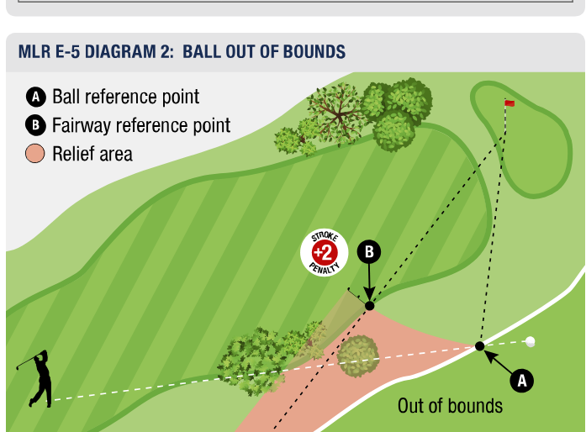
Local Model Rule E-5

Slide 17
Around the Green-Relief or No Relief?
Repair allowed to the putting green (regardless if ball is on or off the putting surface) Rule 8.1
Remove loose Impediments
Remove sand or loose soil
Repair damage to original condition
Repair not allowed off the green
Remove dew, frost, water, sand or loose soil
Remove or press down divots-prior to play
Replace a divot-prior to play

Slide 18
Around the Green-Relief or No Relief?
Local Model Rule F-5.1 Extra option to take relief when immovable obstructions (e.g. sprinkler heads) are on or close to the putting surface or in the line of intended play.
Obstruction (e.g. sprinkler head) must be on the line of play AND
Obstruction must be within 2-club lengths of the ball
Do You Get Relief From a Sprinkler Head Near the Putting Green? Golf Rules (youtube.com)

Slide 19
Marking Your Ball
To show the spot where a ball is at rest by either:
Placing a ball-marker right behind or right next to the ball, or
Holding a club on the ground right behind or right next to the ball.
This is done to show the spot where the ball must be replaced after it is lifted.
When must a ball be marked
Before lifting a ball from the putting green
To identify player's ball
When ‘preferred lies’ or ‘lift/clean/place’ is allowed
To determine if the ball lies in a hole made by an animal
A marker must be removed before making a stroke
When marking is optional
When taking relief
https://www.youtube.com/shorts/kuWV9r0JrHc?feature=share

Slide 20
Marking Your Ball
If a player's ball has become cut during the hole being played, they may put another ball into play by dropping it as near as possible to where the original ball lay. (Ref. 500Q-312)
True
False
The statement is False. The player may substitute the cut ball; however, the player must place a ball rather than drop a ball.
See Rule 4.2c(2)

Slide 21
Marking Your Ball
A player's ball lies on a putting green near the fringe. The player marks and lifts the ball. The player tries twice and is unable to replace the ball on the original spot. If the nearest spot to replace the ball so that it will remain in place is on the fringe, the player must replace the ball off the putting green in that location. (Ref. SN-205)
True
False
The statement is True. The player must place the ball on the spot nearest to the original spot where the ball will remain in place which may be in the general area. The player is not entitled to place the ball on the putting green.
See Rule 14.2e

Slide 22
Marking Your Ball
Removal of a ball-marker causes a player's ball to move. There is no penalty. (Ref. TF-81)
True
False
The statement is True. There is never a penalty for accidentally causing a ball to move while marking and lifting a ball or while replacing a ball. This is true regardless of where the ball lies on the course.
There is also never a penalty for accidentally causing a ball to move on the putting green "no matter how it happens" (Rule 9.4b Exception 3 and Rule 13.1d(1)).
See Rule 9.4b Exception 1

Slide 23
Marking Your Ball
A player lifts their ball for identification and identifies it as theirs. Before replacing the ball, the player notices a lump of mud adhering to the ball. Which of the following is true? (Ref. RQ-38)
A. If before the ball was lifted, the mud interfered with the player's stroke, the player is required to replace the ball so that the interference still exists.
B. When replacing the ball, the player may rotate the ball in any direction.
C. If before the ball was lifted, the ball was in a rotation such that the ball rested on the mud, the ball must be replaced in the same situation, resting on the mud to maintain vertical distance.
The answer is (C) because when there is mud on the ball it can be replaced in almost any direction.(See Clarification 14.2c/1). When a ball is replaced it must maintain the same vertical distance from the ground.
This means that if the mud was beneath the ball and the mud was resting on the ground, the ball must be replaced with the mud beneath the ball in order to maintain the same vertical position. If the mud was in any other position on the ball, the ball can be rotated into any position that the player chooses other than with the mud resting on the ground.
See Rule 14.2c and Clarification 14.2c/1

Slide 24
Match Play vs. Stroke Play
Match Play
Each hole is won, lost or tied
Loss of hole
Teeing outside of tee box-opponent can force a re-hitting of the ball
Must hit in order unless certain circumstances present
Player may verbally concede a next stroke or a hole
Players cannot ‘agree’ to concede holes for purpose of shortening the match
Player must share score with opponent when asked-failing to do so is loss of hole
Stroke Play
Score is cumulative of 18 or more holes
General Penalty-2 strokes
Teeing outside of tee box-general penalty and must be corrected before beginning the next hole
Encourage ready golf
Players must hole out each hole
Players are not obligated to share score
Post round scores must be certified

Slide 25
Match Play
In match play, a hole may be tied when, after the hole has begun, the player and opponent agree to consider the hole tied. There is no penalty for doing so. (Ref. 500Q-257)
True
False
The statement is True. Players must wait until one of the players has started a hole before the players can agree that the hole is tied. Players cannot agree that a hole is tied before either player starts the hole, but one of the players could concede the hole before either player starts the hole.
See Rule 3.2a(2)

Slide 26
Match Play
In match play between A and B, A concedes a hole to B. A then immediately learns that B played a wrong ball with their last stroke and requests a ruling. The Committee must award the hole to A if A requests a ruling. (Ref. 500Q-263)
True
False
The hole was over when Player B played a wrong ball.
True-Even though Player A conceded the hole to Player B, because Player A did not become aware of Player B's loss of hole penalty until after the concession the hole must be awarded to Player A as long as Player A makes a timely ruling to the Committee (before either player makes a stroke on the next hole).
See Rule 3.2d(2) and Rule 6.3c(1)

Slide 27
Match Play
After conceding a hole, a player learns that they were entitled to a handicap stroke on the hole and requests a ruling. The Committee should revoke the concession. (Ref. 500Q-268)
True
False
The statement is False. A concession cannot be withdrawn. Once it is made it is final unless incorrect information as to strokes taken was provided to the opponent. In this case players are responsible for knowing where handicap strokes are to be applied. The application of handicap strokes is not considered "strokes taken information".
See Rule 3.2b and 3.2c

Slide 28
Thank you!
Presentation will be posted on ONSGA website

Slide 29
Abnormal Course Conditions
A player's tee shot lies in a bunker. Without making a stroke at the ball and without having interference from an abnormal course condition, the only way the player can "escape" the bunker is by taking 2 penalty strokes. (Ref. SN-220)
True
False
The statement is False. The player can also take stroke and distance by returning to the teeing area for 1 penalty stroke.
See Rule 16.1c(2) and Rule 18.1

Slide 30
Topic Suggestions
Free Relief (immovable obstructions-cart path when OB or penalty in play)
Rules around the green
Chipping from off the green-actions allowed not allowed
Repair on the green or line of play from off green
Local Rule F-5 for sprinkler head relief
Hitting another ball on the green)
Local Rule E-5 Alternative to S&D for Lost Ball and OB
Provisional Ball rules, when not to use a provisional (i.e. when in a penalty area vs. OB)
Ball Marking required and what constitutes proper marking.
Local rules that will be in effect for this tournament.
Red/Yellow penalty areas
Stroke Play vs. Match Play

